Slide 1
Uniting Africa: Cultivating Leadership for a Prosperous and Peaceful Future
STEPHEN MBURU GATHIMA C025-01-1869/2020

Slide 2

Introduction to African Unity
“In a world of diversity, Africa stands as a continent of potential. This presentation explores the significance of uniting Africa through leadership that fosters a prosperous and peaceful future for all its nations. Together, we can harness our strengths and address our challenges.“
Addition
"Africa, shinda faraja marekani, Mwafrika kuuwa mwafrika, Mwafrika kujisahau, Mwafrika mjinga, Mwafrika mpenda vyawenyewe."

Slide 3

The Importance of Leadership
"Effective leadership is crucial for driving change and development. Leaders must inspire collaboration and promote sustainable practices that benefit communities. By cultivating strong leaders Africa can navigate its complex challenges and create a thriving environment for all citizens."
"Uongozi mbaya, Chakula shinda, Wizi kwa wanasiasa, Mali zetu zikiporwa bila huruma."

Slide 4

Education and Empowerment
"Investing in education is key to cultivating capable leaders. By providing access to quality education and empowerment programs we can equip the next generation with the skills needed to foster innovation and economic growth across the continent."
Addition: "Ni wakati wa kuamka, kujitambua tena, Kuunganisha nguvu zetu na sauti zetu, Kuongoza kwa hekima na busara, Kwa manufaa ya vizazi vijavyo, Tupate kuishi kwa amani na ustawi."

Slide 5

Collaboration Across Borders
"To achieve a prosperous future African nations must engage in collaboration. This involves sharing resources knowledge and best practices. By working together countries can address shared issues such as poverty healthcare and environmental sustainability more effectively."
Addition:
"Tuache kujitafuna wenyewe, Tuache kuuana kwa ajili ya madaraka, Tuache kujisahau na kufuata mikia ya wageni, Tuamke na tuwe na msimamo wa kweli, Tutafute njia ya haki na uadilifu."

Slide 6
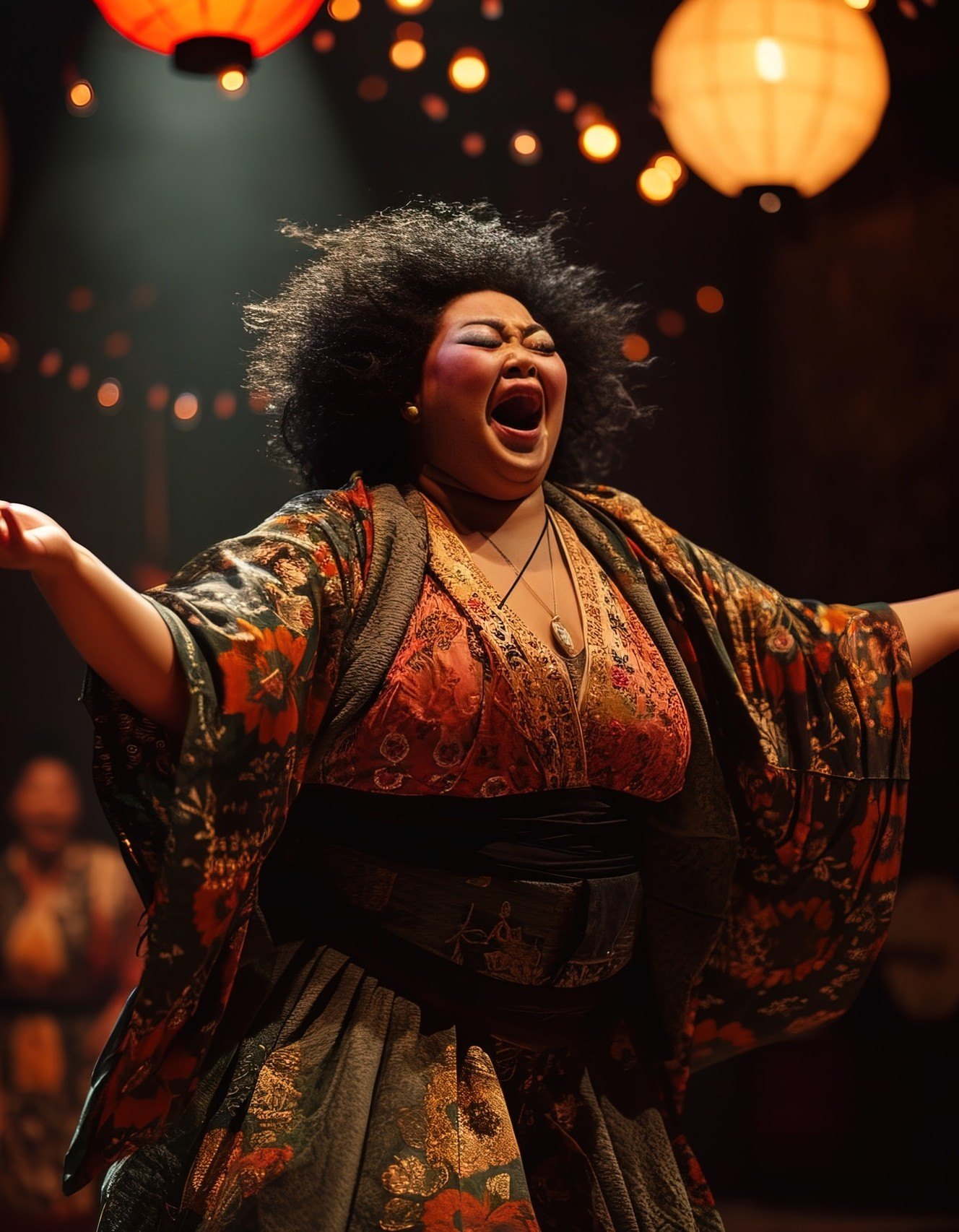
Cultural Heritage and Identity
"Embracing cultural diversity is essential for unity. Africa's rich heritage and traditions should be celebrated and integrated into leadership strategies. By valuing our identities we can strengthen our communities and promote a sense of belonging and pride."
Addition:
"Afrika,
tunahitaji kupaa tena, Kama tai, tukijivunia mali zetu, Tukijenga bara lenye amani na ustawi, Tukibadilisha hadithi zetu, kuwa za ushindi, Tukitembea kwa fahari na ujasiri."

Slide 7

Conclusion: A Uniﬁed Vision
"In conclusion uniting Africa requires a collective vision for the future. By cultivating leadership investing in education and promoting collaboration we can create a prosperous and peaceful continent. Together let us strive for a brighter tomorrow for all Africans."
Addition:
"Afrika,
chombo chetu cha thamani, Tuijenge kwa upendo na hekima, Tuilinde dhidi ya maadui na waporaji, Tuitunze kwa vizazi vijavyo, Iwe mwanga kwa dunia, yenye matumaini mapya."

Slide 8
Thanks!

